Slide 1
Combinational Circuits: MSI Components
Useful MSI circuits
Decoders
Implementing Functions with Decoders
Decoders with Enable
Larger Decoders
Standard MSI Decoders
Implementing Functions with Decoders (2)
Reducing Decoders

Slide 2
Combinational Circuits: MSI Components
Encoder
Demultiplexer
Multiplexer
Multiplexer IC Package
Larger Multiplexers
Standard MSI Multiplexer
Implementing Functions with Multiplexers
Implementing Functions with Smaller Multiplexers

Slide 3
Useful MSI circuits
Four common and useful MSI circuits are:
  Decoder
  Demultiplexer
  Encoder
  Multiplexer
Block-level outlines of MSI circuits:
decoder
encoder
code
entity
entity
code
mux
data
data
demux
output
input
select
select

Slide 4
Decoders
Codes are frequently used to represent entities, e.g. your name is a code to denote yourself (an entity!).
These codes can be identified (or decoded) using a decoder. Given a code, identify the entity.
Convert binary information from n input lines to (max. of) 2^{n} output lines.
Known as n-to-m-line decoder, or simply n:m or n×m decoder (m ≤ 2^{n}).
May be used to generate 2^{n} (or fewer) minterms of n input variables.

Slide 5
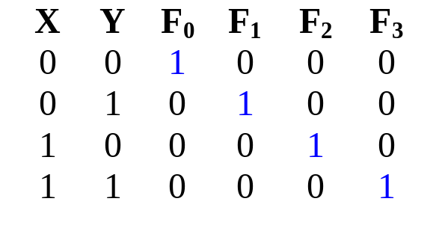
Decoders
Example: if codes 00, 01, 10, 11 are used to identify four light bulbs, we may use a 2-bit decoder:
2x4
Dec
F₀ F₁ F₂ F₃
Bulb 0
Bulb 1
Bulb 2
Bulb 3
2-bit code
X
Y
This is a 2×4 decoder which selects an output line based on the 2-bit code supplied.
Truth table:

Slide 6
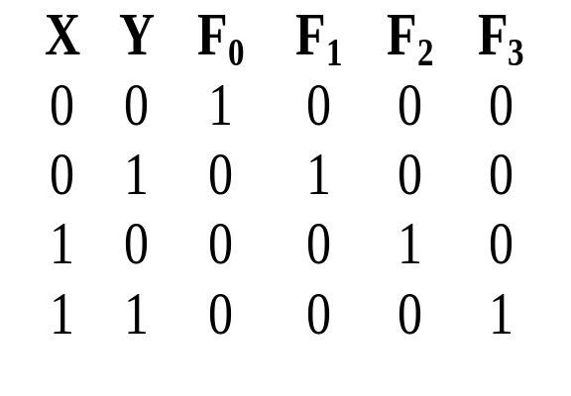
Decoders
From truth table, circuit for 2×4 decoder is:
Note: Each output is a 2-variable minterm (X'.Y', X'.Y, X.Y' or X.Y)
F₀ = X'.Y'
F₁ = X'.Y
F₂ = X.Y'
F₃ = X.Y
X
Y

Slide 7
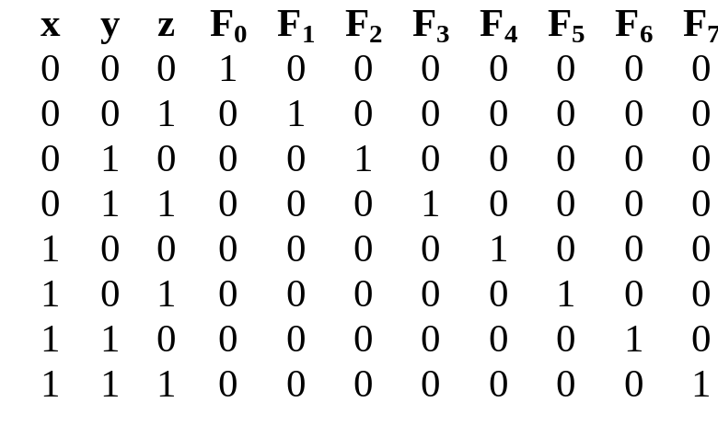
Decoders
Design a 3×8 decoder.
F₀ = x'.y'.z'
F₁ = x'.y'.z
F₂ = x'.y.z'
F₃ = x'.y.z
F₄ = x.y'.z'
F₅ = x.y'.z
Application? Binary-to-octal conversion.
F₆ = x.y.z'
F₇ = x.y.z
x
y
z

Slide 8
Decoders
In general, for an n-bit code, a decoder could select up to 2^{n} lines:
n-bit
code
n to 2^{n}
decoder
up to 2^{n}
output lines
:
:

Slide 9
Decoders: Implementing Functions
A Boolean function, in sum-of-minterms form  decoder to generate the minterms, and an OR gate to form the sum.
Any combinational circuit with n inputs and m outputs can be implemented with an n:2^{n} decoder with m OR gates.
Good when circuit has many outputs, and each function is expressed with few minterms.

Slide 10
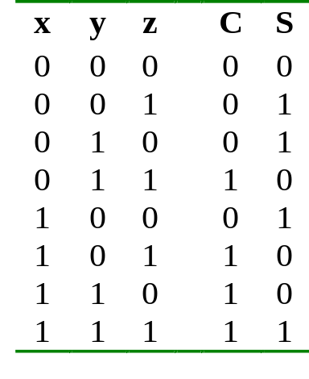
Decoders: Implementing Functions
Example: Full adder
  S(x, y, z) = Σ m(1,2,4,7)
  C(x, y, z) = Σ m(3,5,6,7)
3x8
Dec
0
1
2
3
4
5
6
7
S
x
S₂
S₁
S₀
y
z
C

Slide 11
Decoders: Implementing Functions
3x8
Dec
0
1
2
3
4
5
6
7
1
0
0
0
0
0
0
0
S
0
0
0
0
x
S₂
S₁
S₀
y
C
0
z

Slide 12
Decoders: Implementing Functions
3x8
Dec
0
1
2
3
4
5
6
7
0
1
0
0
0
0
0
0
S
1
0
0
1
x
S₂
S₁
S₀
y
C
0
z

Slide 13
Decoders: Implementing Functions
3x8
Dec
0
1
2
3
4
5
6
7
0
0
0
0
0
0
0
1
S
1
1
1
1
x
S₂
S₁
S₀
y
C
1
z

Slide 14
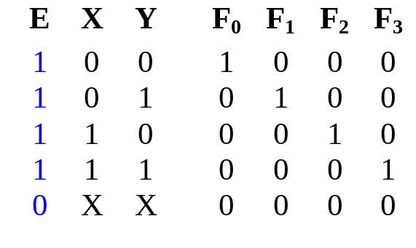
Decoders with Enable
Decoders often come with an enable signal, so that the device is only activated when the enable, E=1.
Truth table:
F₀ = EX'Y'
F₁ = EX'Y
F₂ = EXY'
F₃ = EXY
Circuit:
X
Y
E

Slide 15
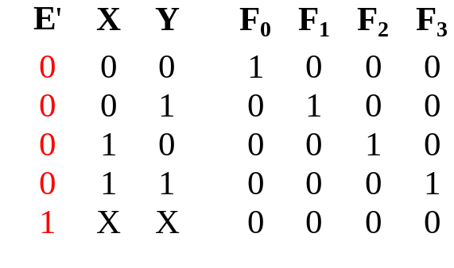
Decoders with Enable
In the previous slide, the decoder has a one-enable signal, that is, the decoder is enabled with E=1.
In most MSI decoders, enable signal is zero-enable, usually denoted by E’ (or E). The decoder is enabled when the signal is zero.
Decoder with 1-enable
Decoder with 0-enable

Slide 16
Larger Decoders
Larger decoders can be constructed from smaller ones.
For example, a 3-to-8 decoder can be constructed from two 2-to-4 decoders (with one-enable), as follows:
3x8
Dec
0
1
:
:
7
F₀ = w'x'y'
F₁ = w'x'y
:
:
F₇ = wxy
w
x
y
S₂
S₁
S₀
2x4
Dec
w
x
y
0
1
2
3
F₀ = w'x'y'
F₁ = w'x'y
F₂ = w'xy'
F₃ = w'xy
S₁
S₀
E
2x4
Dec
0
1
2
3
F₄ = wx'y'
F₅ = wx'y
F₆ = wxy'
F₇ = wxy
S₁
S₀
E

Slide 17
Larger Decoders
3x8
Dec
0
1
:
:
7
F₀ = w'x'y'
F₁ = w'x'y
:
:
F₇ = wxy
w
x
y
S₂
S₁
S₀
0
0
0
2x4
Dec
1
0
0
0
w
x
y
0
1
2
3
F₀ = w'x'y'
F₁ = w'x'y
F₂ = w'xy'
F₃ = w'xy
S₁
S₀
E
1 = enabled
2x4
Dec
0
0
0
0
0
1
2
3
F₄ = wx'y'
F₅ = wx'y
F₆ = wxy'
F₇ = wxy
S₁
S₀
E
0 = disabled

Slide 18
Larger Decoders
3x8
Dec
0
1
:
:
7
F₀ = w'x'y'
F₁ = w'x'y
:
:
F₇ = wxy
w
x
y
S₂
S₁
S₀
0
0
1
2x4
Dec
0
1
0
0
w
x
y
0
1
2
3
F₀ = w'x'y'
F₁ = w'x'y
F₂ = w'xy'
F₃ = w'xy
S₁
S₀
E
1 = enabled
2x4
Dec
0
0
0
0
0
1
2
3
F₄ = wx'y'
F₅ = wx'y
F₆ = wxy'
F₇ = wxy
S₁
S₀
E
0 = disabled

Slide 19
Larger Decoders
3x8
Dec
0
1
:
:
7
F₀ = w'x'y'
F₁ = w'x'y
:
:
F₇ = wxy
w
x
y
S₂
S₁
S₀
1
1
0
2x4
Dec
0
0
0
0
w
x
y
0
1
2
3
F₀ = w'x'y'
F₁ = w'x'y
F₂ = w'xy'
F₃ = w'xy
S₁
S₀
E
0 = disabled
2x4
Dec
0
0
1
0
0
1
2
3
F₄ = wx'y'
F₅ = wx'y
F₆ = wxy'
F₇ = wxy
S₁
S₀
E
1 = enabled

Slide 20
Larger Decoders
Construct a 4x16 decoder from two 3x8 decoders with 1-enable.
4x16
Dec
w
x
y
z
S₃
S₂
S₁
S₀
0
1
:
:
15
F₀
F₁
:
:
F₁₅
3x8
Dec
w
x
y
z
0
1
:
7
F₀
F₁
:
F₇
S₂
S₁
S₀
E
3x8
Dec
S₂
S₁
S₀
0
1
:
7
F₈
F₉
:
F₁₅
E

Slide 21
Decoders: Implementing Functions (2)
Example: Implement the following logic function using decoders and logic gates
f(Q,X,P) = ∑ m(0,1,4,6,7) = ∏ M(2,3,5)
We may implement the function in several ways:
  Use a decoder (with active-high outputs) with an OR gate:
  f(Q,X,P) = m₀ + m₁ + m₄ + m₆ + m₇
  Use a decoder (with active-low outputs) with a NAND gate:
  f(Q,X,P) = ( m₀' . m₁' . m₄' . m₆' . m₇' )'
  Use a decoder (with active-high outputs) with a NOR gate:
  f(Q,X,P) = ( m₂ + m₃ + m₅ )' [ = M₂.M₃.M₅]
  Use a decoder (with active-low outputs) with an AND gate:
  f(Q,X,P) = m₂' . m₃' . m₅'

Slide 22
Decoders: Implementing Functions (2)
f(Q,X,P)
= ∑ m(0,1,4,6,7)
0
1
2
3
4
5
6
7
0
1
2
3
4
5
6
7
3x8
Dec
3x8
Dec
Q
X
P
A
B
C
f(Q,X,P)
Q
X
P
A
B
C
f(Q,X,P)
(a) Active-high decoder with OR gate.
(b) Active-low decoder with NAND gate.
0
1
2
3
4
5
6
7
0
1
2
3
4
5
6
7
3x8
Dec
3x8
Dec
f(Q,X,P)
f(Q,X,P)
Q
X
P
A
B
C
Q
X
P
A
B
C
(c) Active-high decoder with NOR gate.
(d) Active-low decoder with AND gate.

Slide 23
Reducing Decoders
Example:
F(a,b,c) = ∑ m(4,6,7)
Using a 3×8 decoder (assuming 1-enable and active-high outputs).
3x8
Dec
0
1
2
3
4
5
6
7
a
S₂
S₁
S₀
b
F
c
EN
1

Slide 24
Reducing Decoders
We have seen that a decoder may be constructed from smaller decoders.
Below are just some ways of constructing a 3×8 decoder. (Explore other ways youself!)
  Using two 2×4 decoders with an inverter.
2x4
Dec
a
b
c
0
1
2
3
S₁
S₀
E
a'
2x4
Dec
0
1
2
3
S₁
S₀
E
a

Slide 25
Reducing Decoders
  Using two 2×4 decoders and a 1×2 decoder.
2x4
Dec
0
1
2
3
b
c
S₁
S₀
1x2
Dec
E
0
1
a'
a
S
E
2x4
Dec
0
1
2
3
1
S₁
S₀
E
a
Verify this circuit yourself!

Slide 26
Reducing Decoders
  Using four 1×2 decoders and a 2×4 decoder.
1x2
Dec
c
S
0
1
E
1x2
Dec
c
S
0
1
2x4
Dec
0
1
2
3
E
a
b
S₁
S₀
1x2
Dec
E
0
1
c
S
1
E
1x2
Dec
c
S
0
1
Verify this circuit yourself!
E

Slide 27
Reducing Decoders
Using smaller decoders, sometimes we may be able to save some decoders.
Example: F(a,b,c) = ∑ m(4,6,7)
2x4
Dec
0
1
2
3
Question: Do we really need this decoder for F?
b
c
S₁
S₀
1x2
Dec
E
0
1
a'
a
S
E
2x4
Dec
0
1
2
3
1
S₁
S₀
F
E
a

Slide 28
Reducing Decoders
So we can save a decoder.
1x2
Dec
2x4
Dec
a
S
0
1
0
1
2
3
b
c
S₁
S₀
F
E
1
E
Similarly, we can save 2 small decoders below.
1x2
Dec
2x4
Dec
c
S
0
1
0
1
2
3
a
b
S₁
S₀
E
F
E
1x2
Dec
c
S
0
1
1
E

Slide 29
Reducing Decoders
Second example: F(a,b,c) = ∑ m(0,1,2,3,6)
2x4
Dec
0
1
2
3
b
c
S₁
S₀
Question: Can we do something about this?
E
1x2
Dec
2x4
Dec
a
S
0
1
0
1
2
3
b
c
S₁
S₀
F
E
1
E

Slide 30
Reducing Decoders
Second example: F(a,b,c) = ∑ m(0,1,2,3,6)
Yes, we may remove the top 2×4 decoder, and connect the appropriate output from the 1×2 decoder directly to the OR gate.
1x2
Dec
2x4
Dec
a
S
0
1
0
1
2
3
b
c
S₁
S₀
E
F
1
E
Verify that this circuit is correct!

Slide 31
Reducing Decoders
Third example: F(a,b,c) = ∑ m(0,3,4,7)
We have the same pattern of outputs from the 2 decoders (i.e. we take the first and fourth outputs from each decoder). Can we do something about it?
2x4
Dec
0
1
2
3
b
c
S₁
S₀
E
1x2
Dec
2x4
Dec
a
S
0
1
0
1
2
3
F
b
c
S₁
S₀
E
1
E

Slide 32
Reducing Decoders
Third example: F(a,b,c) = ∑ m(0,3,4,7)
If we have the same pattern of outputs from 2 or more decoders at the second level, we may keep one decoder, and use an OR gate on the corresponding outputs from the first-level decoder.
Additional OR gate
1x2
Dec
2x4
Dec
a
S
0
1
0
1
2
3
F
b
c
S₁
S₀
E
1
E
Verify that this circuit is correct!

Slide 33
Reducing Decoders
Third example: F (a,b,c) = ∑ m(0,3,4,7)
Can we still simplify the circuit?
This may be eliminated. (why?)
1x2
Dec
2x4
Dec
a
S
0
1
0
1
2
3
F
b
c
S₁
S₀
E
1
E
Because this is (a' + a) = 1
2x4
Dec
0
1
2
3
F
b
c
S₁
S₀
E
1

Slide 34
Reducing Decoders
Summary:
  If no outputs are needed from a 2nd-level decoder, just remove the decoder.
  If all outputs are needed from a 2nd-level decoder, remove the decoder, and connect the corresponding output from the 1st-level decoder to the OR gate.
  If the set of outputs is the same for 2 or more decoders at the 2nd level, keep one of the decoders and remove the rest. Add an OR gate to take in the appropriate outputs from the 1st-level decoder.
The above procedure may not guarantee a circuit that has the least number of decoders. However, it is easy to follow. (To obtain the optimal circuit in general, we need to play around with the inputs to the decoders, which may be hard.)

Slide 35
Reducing Decoders
Apply what you learned to verify the circuit below for this function: F(a,b,c,d) = ∑ m(0,1,2,3,4,5,12,13)
2x4
Dec
0
1
2
3
a
b
S₁
S₀
2x4
Dec
0
1
2
3
F
E
c
d
S₁
S₀
1
E

Slide 36
Encoder
Encoding is the converse of decoding.
Given a set of input lines, where one has been selected, provide a code corresponding to that line.
Contains 2^{n} (or fewer) input lines and n output lines.
Implemented with OR gates.
An example:
F₀
D₀
Select via switches
F₁
4-to-2 Encoder
F₂
2-bits code
F₃
D₁

Slide 37
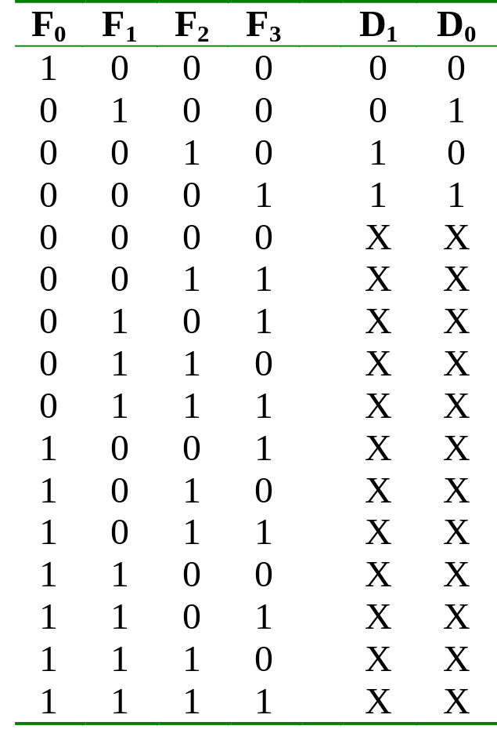
Encoder
Truth table:

Slide 38
Encoder
With the help of K-map (and don’t care conditions), can obtain:
D₀ = F1 + F3
D₁ = F2 + F3
which correspond to circuit:
F₀
F₁
D₀
Simple 4-to-2 encoder
F₂
F₃
D₁

Slide 39
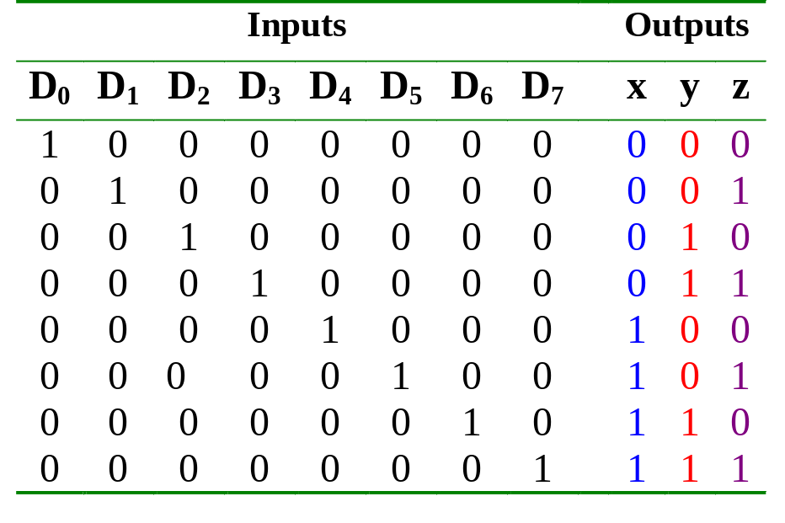
Encoder
Example: Octal-to-binary encoder.
  At any one time, only one input line has a value of 1.

Slide 40
Encoder
Example: Octal-to-binary encoder.
D₀
D₁
D₂
D₃
D₄
D₅
D₆
D₇
x = D₄ + D₅ + D₆ + D₇
y = D₂ + D₃ + D₆ + D₇
z = D₁ + D₃ + D₅ + D₇
8-to-3 encoder
Exercise: Can you design a 2^{n}-to-n encoder without the K-map?

Slide 41
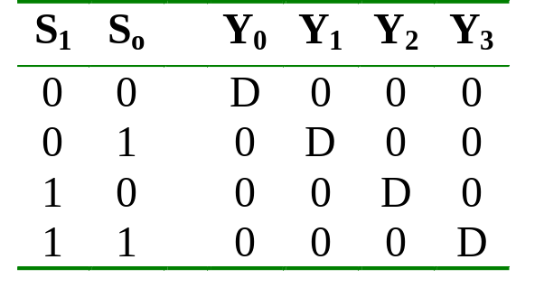
Demultiplexer
Given an input line and a set of selection lines, the demultiplexer will direct data from input to a selected output line.
An example of a 1-to-4 demultiplexer:
Outputs
Y₀ = D.S₁'.S₀'
Y₁ = D.S₁'.S₀
Data D
demux
Y₂ = D.S₁.S₀'
Y₃ = D.S₁.S₀
S₁ S₀
select

Slide 42
Demultiplexer
The demultiplexer is actually identical to a decoder with enable, as illustrated below:
Y₀ = D.S₁'.S₀'
2x4 Decoder
S₁
S₀
Y₁ = D.S₁'.S₀
Y₂ = D.S₁.S₀'
E
Y₃ = D.S₁.S₀
D
Exercise: Provide the truth table for above demultiplexer.

Slide 43
Multiplexer
A multiplexer is a device which has
(i) a number of input lines
(ii) a number of selection lines
(iii) one output line
It steers one of 2^{n} inputs to a single output line, using n selection lines. Also known as a data selector.
2^{n}:1
Multiplexer
inputs
output
:
...
select

Slide 44
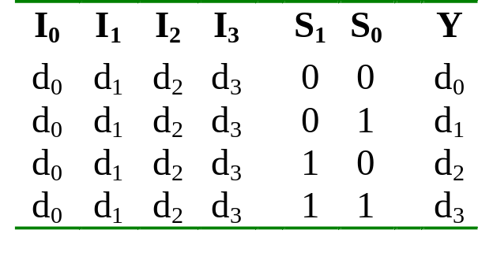
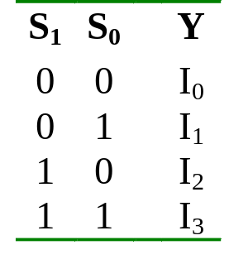
Multiplexer
Truth table for a 4-to-1 multiplexer:
Inputs
Inputs
I₀
0
1
2
3
I₀
I₁
4:1
MUX
I₁
I₂
Y
Output
I₂
mux
Y
I₃
I₃
S₁ S₀
S₁ S₀
select
select

Slide 45
Multiplexer
Output of multiplexer is
“sum of the (product of data lines and selection lines)”
Example: the output of a 4-to-1 multiplexer is:
Y = I₀.(S₁’.S₀') + I₁.(S₁’.S₀) + I₂.(S₁.S₀') + I₃.(S₁.S₀)
A 2^{n}-to-1-line multiplexer, or simply 2^{n}:1 MUX, is made from an n: 2^{n} decoder by adding to it 2^{n} input lines, one to each AND gate.

Slide 46
Multiplexer
I₀
I₀
I₁
I₁
Y
Y
I₂
I₂
I₃
I₃
0 1 2 3
2-to-4 Decoder
S₁
S₀
S₁
S₀
Four-to-one multiplexer design.

Slide 47
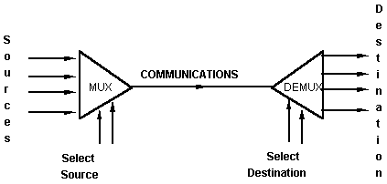
Multiplexer
An application:
Helps share a single communication line among a number of devices.
At any time, only one source and one destination can use the communication line.

Slide 48
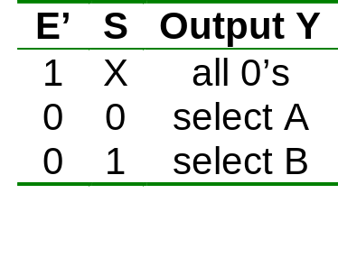
Multiplexer IC Package
Some IC packages have a few multiplexers in each package. The selection and enable inputs are common to all multiplexers within the package.
A₀
A₁
A₂
A₃
Y₀
Y₁
Y₂
Y₃
B₀
B₁
B₂
B₃
S
(select)
Quadruple 2:1 multiplexer
E'
(enable)

Slide 49
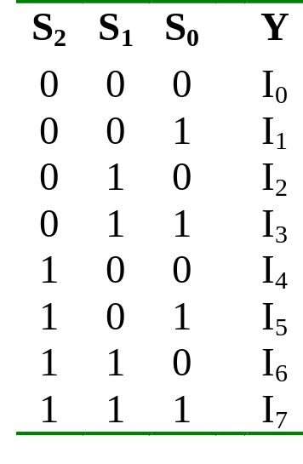
Larger Multiplexers
Larger multiplexers can be constructed from smaller ones.
An 8-to-1 multiplexer can be constructed from smaller multiplexers like this (note placement of selector lines):
I₀
I₁
I₂
I₃
4:1 MUX
2:1 MUX
S₁ S₀
Y
I₄
I₅
I₆
I₇
4:1 MUX
S₂
S₁ S₀

Slide 50
Larger Multiplexers
When
S₂S₁S₀ = 000
I₀
I₁
I₂
I₃
4:1 MUX
I₀
I₀
2:1 MUX
S₁ S₀
Y
I₄
I₅
I₆
I₇
4:1 MUX
I₄
S₂
S₁ S₀

Slide 51
Larger Multiplexers
When
S₂S₁S₀ = 001
I₀
I₁
I₂
I₃
4:1 MUX
I₁
I₁
2:1 MUX
S₁ S₀
Y
I₄
I₅
I₆
I₇
4:1 MUX
I₅
S₂
S₁ S₀

Slide 52
Larger Multiplexers
When
S₂S₁S₀ = 110
I₀
I₁
I₂
I₃
4:1 MUX
I₂
I₆
2:1 MUX
S₁ S₀
Y
I₄
I₅
I₆
I₇
4:1 MUX
I₆
S₂
S₁ S₀

Slide 53
Larger Multiplexers
Another implementation of an 8-to-1 multiplexer using smaller multiplexers:
When
S₂S₁S₀ = 000
I₀
I₁
2:1 MUX
I₀
I₂
I₃
2:1 MUX
I₂
S₀
4:1 MUX
I₀
S₀
Y
I₄
I₅
2:1 MUX
I₄
S₂ S₁
S₀
I₆
I₇
2:1 MUX
I₆
Q: Can we use only 2:1 multiplexers?
S₀

Slide 54
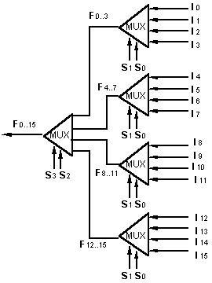
Larger Multiplexers
A 16-to-1 multiplexer can be constructed from five 4-to-1 multiplexers:

Slide 55
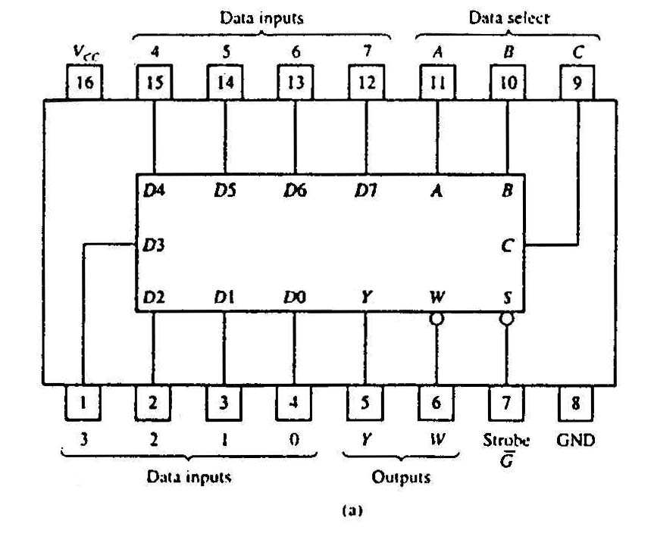
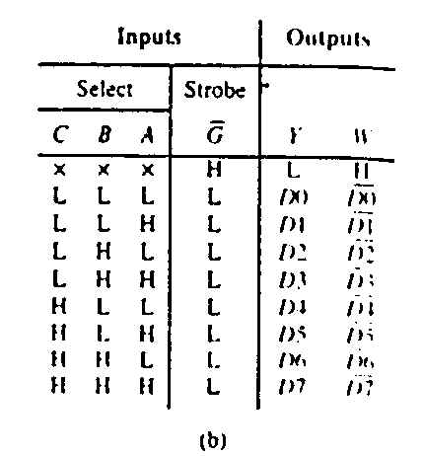
Standard MSI Multiplexer
74151A 8-to-1 multiplexer. (a) Package configuration. (b) Function table.

Slide 56
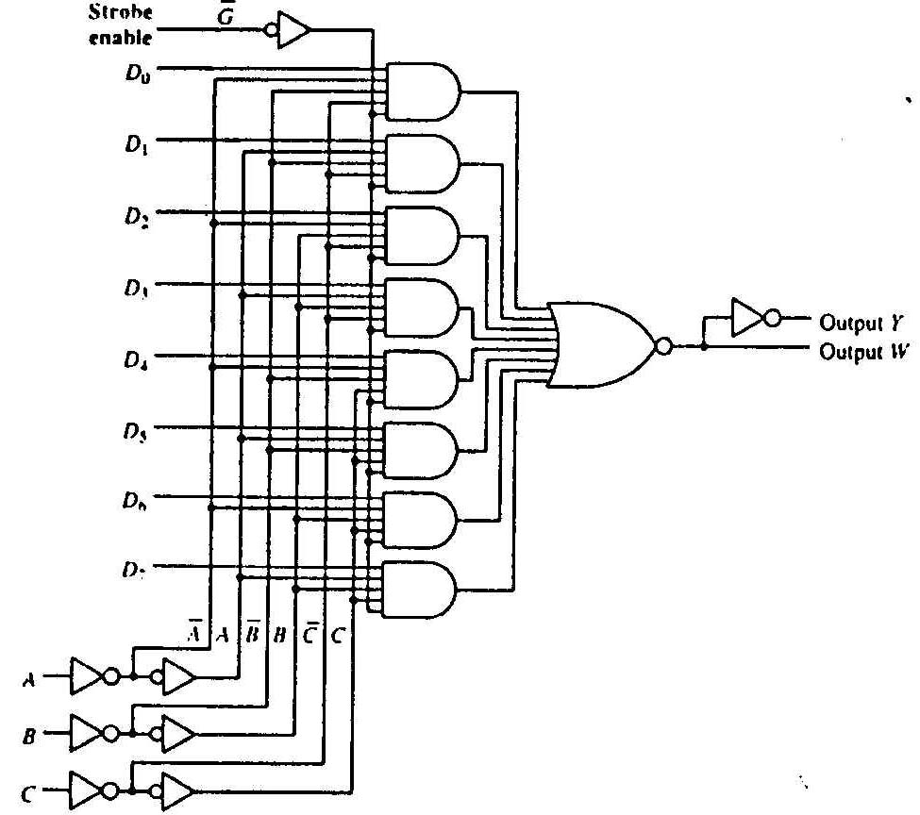
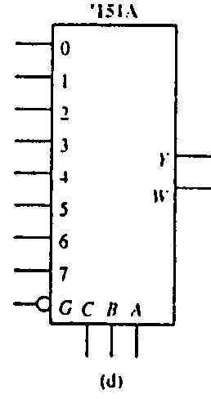
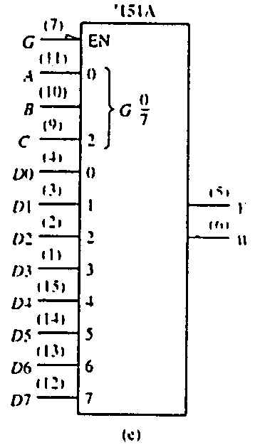
Standard MSI Multiplexer
74151A 8-to-1 multiplexer. (c) Logic diagram. (d) Generic logic symbol. (e) IEEE standard logic symbol.
Source: The TTL Data Book Volume 2. Texas Instruments Inc.,1985.

Slide 57
Multiplexers: Implementing Functions
A Boolean function can be implemented using multiplexers.
A 2^{n}-to-1 multiplexer can implement a Boolean function of n input variables, as follows:
  (i) Express in sum-of-minterms form.
Example: F(A,B,C) = A'B'C + A'BC + AB'C + ABC'
= Σ m(1,3,5,6)
  (ii) Connect n variables to the n selection lines.
  (iii) Put a '1' on a data line if it is a minterm of the function, '0' otherwise.

Slide 58
Multiplexers: Implementing Functions
F(A,B,C) = Σ m(1,3,5,6)
0
1
0
1
0
1
1
0
0
1
2
3
4
5
6
7
This method works because:
Output = m₀.I₀ + m₁.I₁ + m₂.I₂ + m₃.I₃ + m₄.I₄ + m₅.I₅ + m₆.I₆ + m₇.I₇
Supplying ‘1’ to I₁,I₃,I₅,I₆ , and ‘0’ to the rest:
Output = m₁ + m₃ + m₅ + m₆
F
mux
A B C

Slide 59
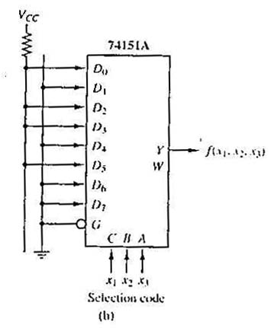
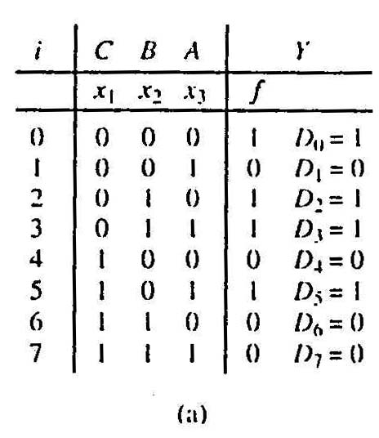
Multiplexers: Implementing Functions
Example: Use a 74151A to implement:
f(x₁,x₂,x₃) = ∑ m(0,2,3,5)
Realization of f(x₁,x₂,x₃) = ∑m(0,2,3,5).
(a)Truth table.
(b)Implementation with 74151A.

Slide 60
Using Smaller Multiplexers
Earlier, we saw how a 2^{n}-to-1 multiplexer can be used to implement any Boolean function of n (input) variables.
However, we can use a single smaller 2^{(n-1)}-to-1 multiplexer to implement any Boolean function of n (input) variables.
In particular, the earlier function
F(A,B,C) = ∑ m(1,3,5,6)
can be implemented using a 4-to-1 multiplexer (rather than an 8-to-1 multiplexer).

Slide 61
Using Smaller Multiplexers
Let’s look at this example:
F(A,B,C) = Σ m(0,1,3,6) = A’B’C’ + A’B’C + A’BC + ABC’
A’B’
1
1
0
1
0
0
1
0
0
1
2
3
4
5
6
7
1
C
0
C'
0
1
2
3
F
mux
F
mux
A B C
A B
Note: Two of the variables, A, B, are applied as selection lines of the multiplexer, while the inputs of the multiplexer contain 1, C, 0 and C'.

Slide 62
Using Smaller Multiplexers
Procedure
  1) Express boolean function in “sum-of-minterms” form.
  e.g. F(A,B,C)= Σ m(0,1,3,6)
  2) Reserve one variable (in our example, we take the least significant one) for input lines of multiplexer, and use the rest for selection lines.
  e.g. C is for input lines, A and B for selection lines.

Slide 63
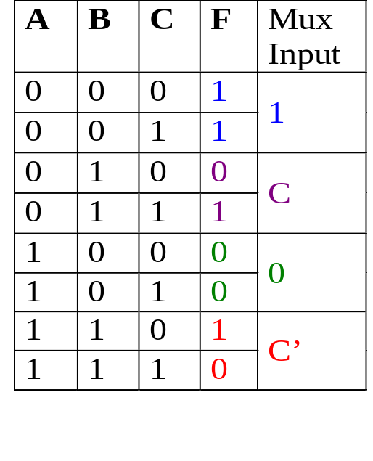
Using Smaller Multiplexers
  3) Draw the truth table for function, but grouping inputs by selection line values, and then determine multiplexer inputs by comparing input line (C) and function (F) for corresponding selection line values.
1
0
0
1
2
3
C
F
mux
A B

Slide 64
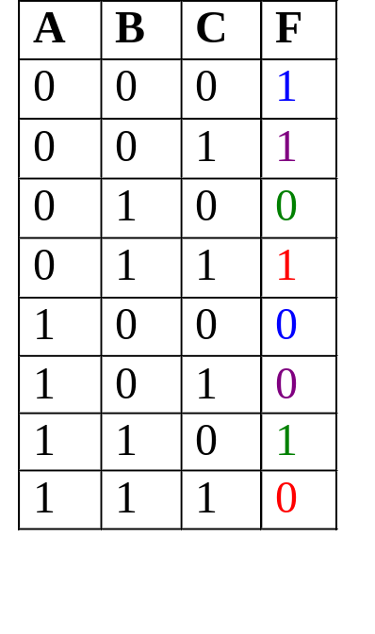
Using Smaller Multiplexers
Alternative: What if we use A for input lines, and B, C for selector lines?
A’ (when BC = 00)
A’ (when BC = 01)
A (when BC = 10)
A
0
1
2
3
F
A’ (when BC = 11)
mux
B C

Slide 65
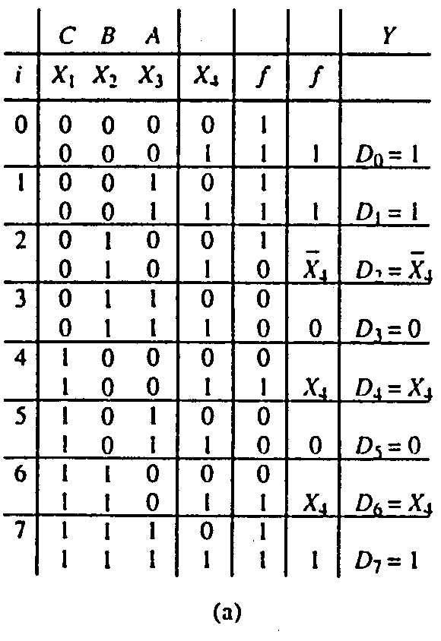
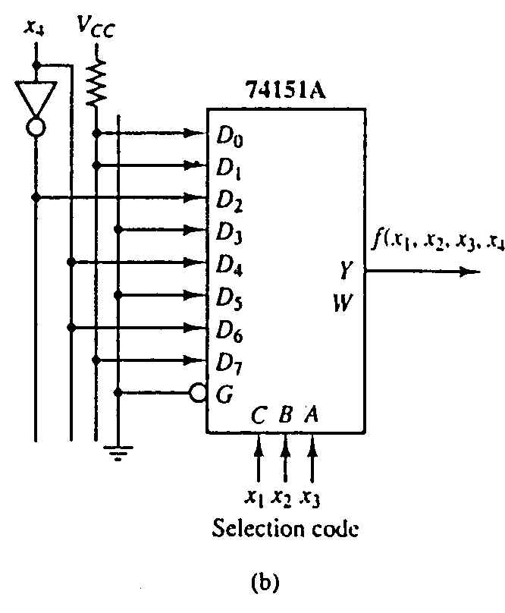
Using Smaller Multiplexers
Example: Implement using a 74151A the function:
f(x₁,x₂,x₃,x₄) = ∑ m(0,1,2,3,4,9,13,14,15)

Slide 66
End of file

